Slide 1
Battle of Neighborhood in Singapore
Which area should an expat choose for their first house
By ZHANG LIBO

Slide 2
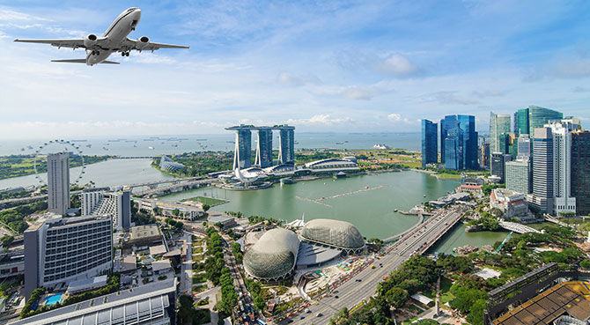
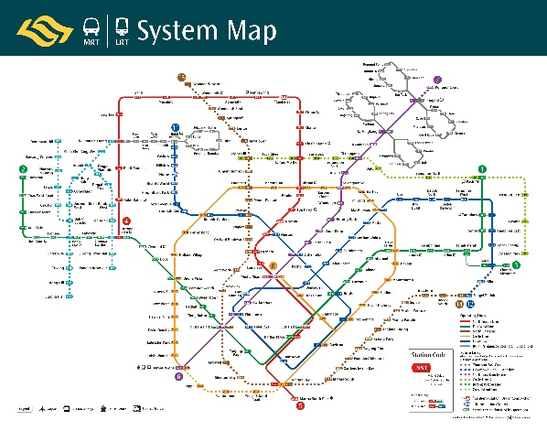
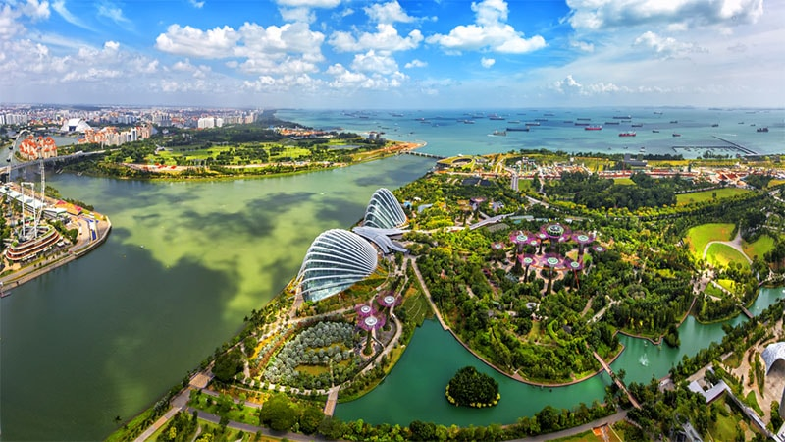
Problem Statement
Singapore is one of the top chosen destinations for relocation by expatriates.
When an expat decide to move to Singapore, the first and most intuitive question is:
where should I live?
I have a family, a two bedrooms unit could be suitable, I have a budget of 3000 SGD, I love Chinese Food/Asia Food, I love shopping…

Slide 3
Data
A Few Assumptions:
Most Expatriates works in CBD area
He/she would want a two bedroom units which could be suitable if there is a family member visiting
Commuting time budget is about 30min.
With a budget of 3000SGD, an expatriate could get a one-bedroom or just a studio in CCR region, while in Rest of Central Region (RCR), he/she could rent a two-bedroom condo unit. The commute time from RCR to CBD is within 30min by public transport or less than 20min by car.

Slide 4
Data
Map to see the areas spreading in the whole island. Noted that the downtown of Singapore is not at the centre but rather South of island. The downtown spot is highlighted using red circle.

Slide 5
Data
Use Foursquare API to explore the venues in RCR areas
Number of Venues less than 20 are:
Siglap
Queenstown
Tanjong Rhu
Braddel Road
Pasir Panjang
Eunos
Dover
Keppel
Thomson

Slide 6
Data
TOP 5 areas with most of “Shops”
1. Bugis
2. Bencoolen
3. Bishan
4. Ang Mo Kio
5. Toa Payoh

Slide 7
Results
Elbow method to determine best K.
K-mean Clustering
Cluster 0 → Mid-Class Chinese Zone
Cluster 1 → Classic Living Zone
Cluster 2 → Mixed Living Zone
Cluster 3 → Relax Zone
Cluster 4 → Little Indian Zone

Slide 8
Results
Elbow method to determine best K.
K-mean Clustering
Cluster 0 → Mid-Class Chinese Zone
Cluster 1 → Classic Living Zone
Cluster 2 → Mixed Living Zone
Cluster 3 → Relax Zone
Cluster 4 → Little Indian Zone

Slide 9
Discussion
Let’s go back to the top 5 areas that we draw from those with most shops, Bugis and Bencoolen is at Relax Zone. Bishan/Ang Mo Kio/Toh Payoh belongs to Classic Living Zone.
1. Bugis → Relax Zone
2. Bencoolen → Relax Zone
3. Bishan → Classic Living Zone
4. Ang Mo Kio → Classic Living Zone
5. Toa Payoh → Classic Living Zone
Based on above analysis and review, depends on the background of the expatriates, I would suggest different area for them to start with at the beginning their journey in Singapore. For example, a Chinese family with housewife and kids, I would suggest staying in Bishan/Ang Mo Kio/Toa Payoh, they could enjoy convenience brought by plenty of shops and amenities, with easy access of public transport, they can reach any part of island easily. Another example, an Indian single professional, I would suggest renting a place in Little India or Ferry Park, where he could enjoy most authentic Indian food and social with people having similar background or culture. A young couple both loving Chinese/Asian food could choose Mid-Class Chinese Zone as well since they have most Chinese restaurants and Asia food available.

Slide 10
Battle of Neighborhood in Singapore
Back up
(Click the arrow when in Slide Show mode)
Notes:
In Slide Show mode, click the arrow to enter the PowerPoint Getting Started Center.

Slide 11
K-mean Clustering

